Slide 1

LionBee
Aaron Voon Pin Jia (S10242049)
Curtis Lee Bing Xian (S10247748)
Elliot Ng (S10222410)
Klayton Tan Zhi Yu (S10242375)
Vernon Koh Wei Neng (S10248408)

Slide 2
Problem Statement
How might we use Technology to offer an easy and user-friendly way for seniors to perform preliminary self-assessment in the comfort of their own homes, with vulnerable cases being highlighted for further clinical assessment by doctors?

Slide 3
Key Features

Slide 4
Modular Microservices Architecture
Independent services for user management, assessments, cognitive training, chatbot interactions, and AI-powered video analysis.
Each service has its own database, ensuring data isolation and fault tolerance.
Services communicate using RESTful APIs, allowing flexibility and scalability.

Slide 5
AI-Powered Fall Risk Assessment
Assessment Service: Uses a questionnaire and scoring system to determine fall risk.
Video Analysis Service: Uses AI-driven motion tracking (MediaPipe & OpenCV) to analyze walking patterns and posture stability.

Slide 6
Cognitive Training & Multi-Language Chatbot
Game Service: Includes a Memory Card Matching game to improve mental agility.
LionBee Chatbot: AI-powered speech-to-text assistant supporting English, Chinese, Malay, and Tamil.

Slide 7
Scalable & Fault-Tolerant System
Independent databases ensure fault isolation (one service failure doesn’t impact others).
Dockerized deployment allows services to be scaled independently based on demand.

Slide 8
System Requirements & Deployment
Runs on Go, Python, Docker, and requires at least 4GB RAM (8GB recommended).
Supports containerized deployment with docker-compose for efficient service management.

Slide 9
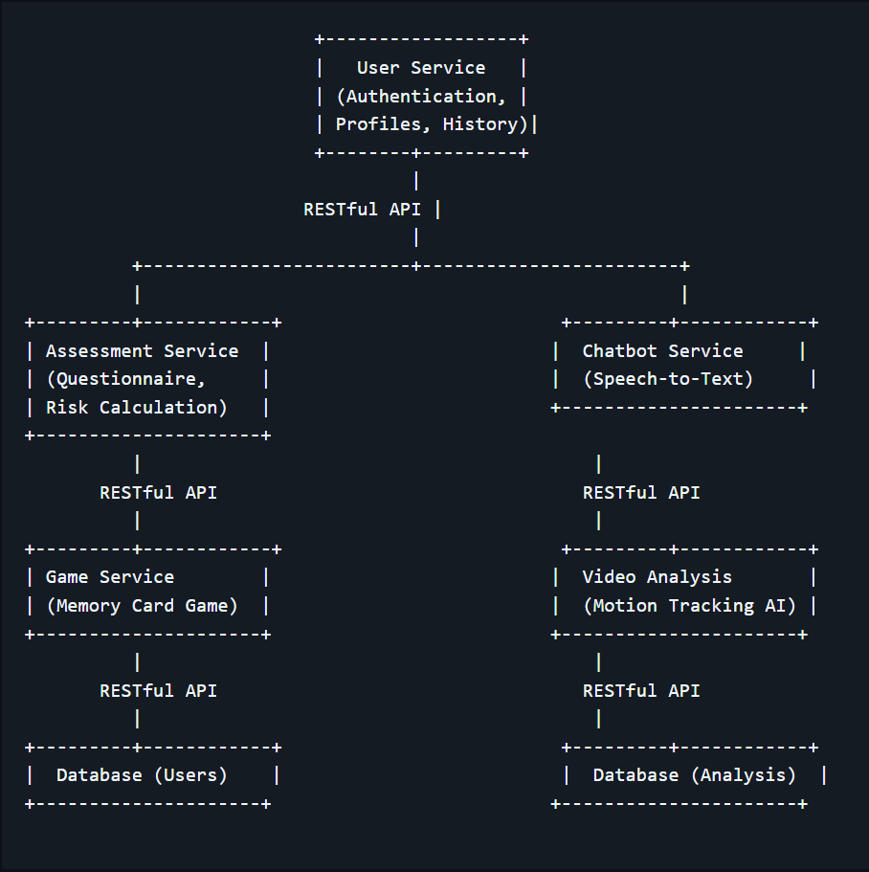
Architecture Diagram

Slide 10
Demo

Slide 11
Thank you!

